Slide 1
Phishing Sites Predictor
Guided by : Ms.Rayavarapu Sri Divya
M.Tech, Assistant Professor
Batch-12
1.Poluparthi Kamalatha [19P31A05A6]
2.Nalli Prathyusha [19P31A0598]
3.Ganapavarapu Poojitha [19P31A0584]
4.Vanamadi Ravi Sai Kumar [19P31A05B8]

Slide 2
Contents
Abstract
Requirements
Hardware and Software
Datasets considered to build model
Analysis
Novelty in the proposed system
Block diagram of proposed system
Features extracting from dataset
Modules Identified in the system
System Architecture
System Design
UML Diagrams
User Interface screens design
Dataset structure
Conclusion

Slide 3
Abstract:
Phishing a form of social engineering attack, which has an adverse effect on people where the user is directed to fake websites and duped to reveal their sensitive and personal information which includes passwords of accounts, bank details, atm pin-card details etc. Hence protecting sensitive information from malwares or web phishing is difficult. By using Machine learning algorithms we will be identifying phishing attacks and report their positives and negatives.

Slide 4
Software Requirements
Python
PyCharm
Important Libraries used are:
Pandas
Scikit Learn
RegexpTokenizer
Snowball Stemmer
Count vectorizer
pickle
Fast API
joblib

Slide 5
Hardware Requirements
RAM (8GB)
Windows 10 operating system
Processor( Intel core i5)
256 GB HDD (Minimum)
Machine learning Algorithms
Logistic Regression
Multinomial Naïve Bayes
Datasets considered to build model
https://www.kaggle.com/datasets/taruntiwarihp/phishing-site-urls

Slide 6
Novelty in the proposed system
Here we proposed a new method of anti-phishing technology. The Anti-Phishing Technology using Machine Learning Approach i.e., Logistic regression and Multinomial NB to ensure best prediction.
One of the key novelties of using logistic regression for phishing site prediction is that it can effectively handle large datasets with numerous variables.
In this mechanism we deal with the URLs (Uniform Resource Locators) technique and predict whether it is phishing website or not.
Here we create a web API. Each time we browse a site the corresponding URL (Uniform Resource Locator) of site will be checked with machine learning technique.
Implementation of this project is done by creating an app using python programming language and FASTAPI.

Slide 7
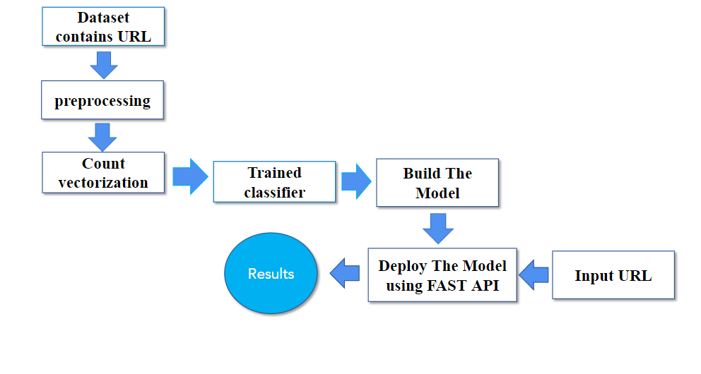
Block Diagram of Proposed Approach:-

Slide 8
Features extracting from dataset
The selected features are expected to contain the appropriate information from the input data, so that the desired task can be performed by using this reduced demonstration instead of the complete initial data. Since the URLs are in our dataset are different from our normal text documents so tokenized text, stemmed text, sent text features are extracted and then we have to use text feature extraction method to construct a feature vector.
Count vectorizer : The most straightforward one, it counts the number of times a token shows up in the document and uses this value as its weight.
Count vectorizer is a method to convert text to numerical data.

Slide 9
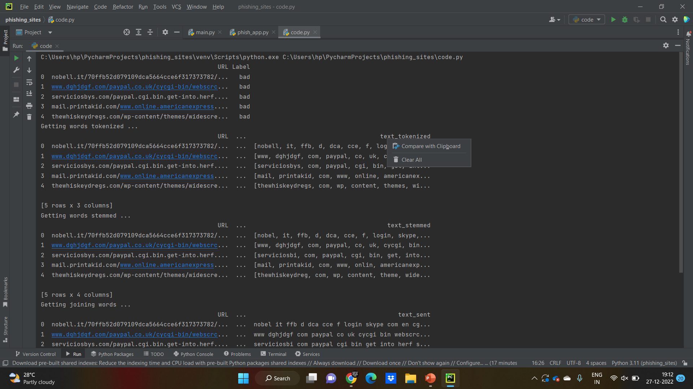
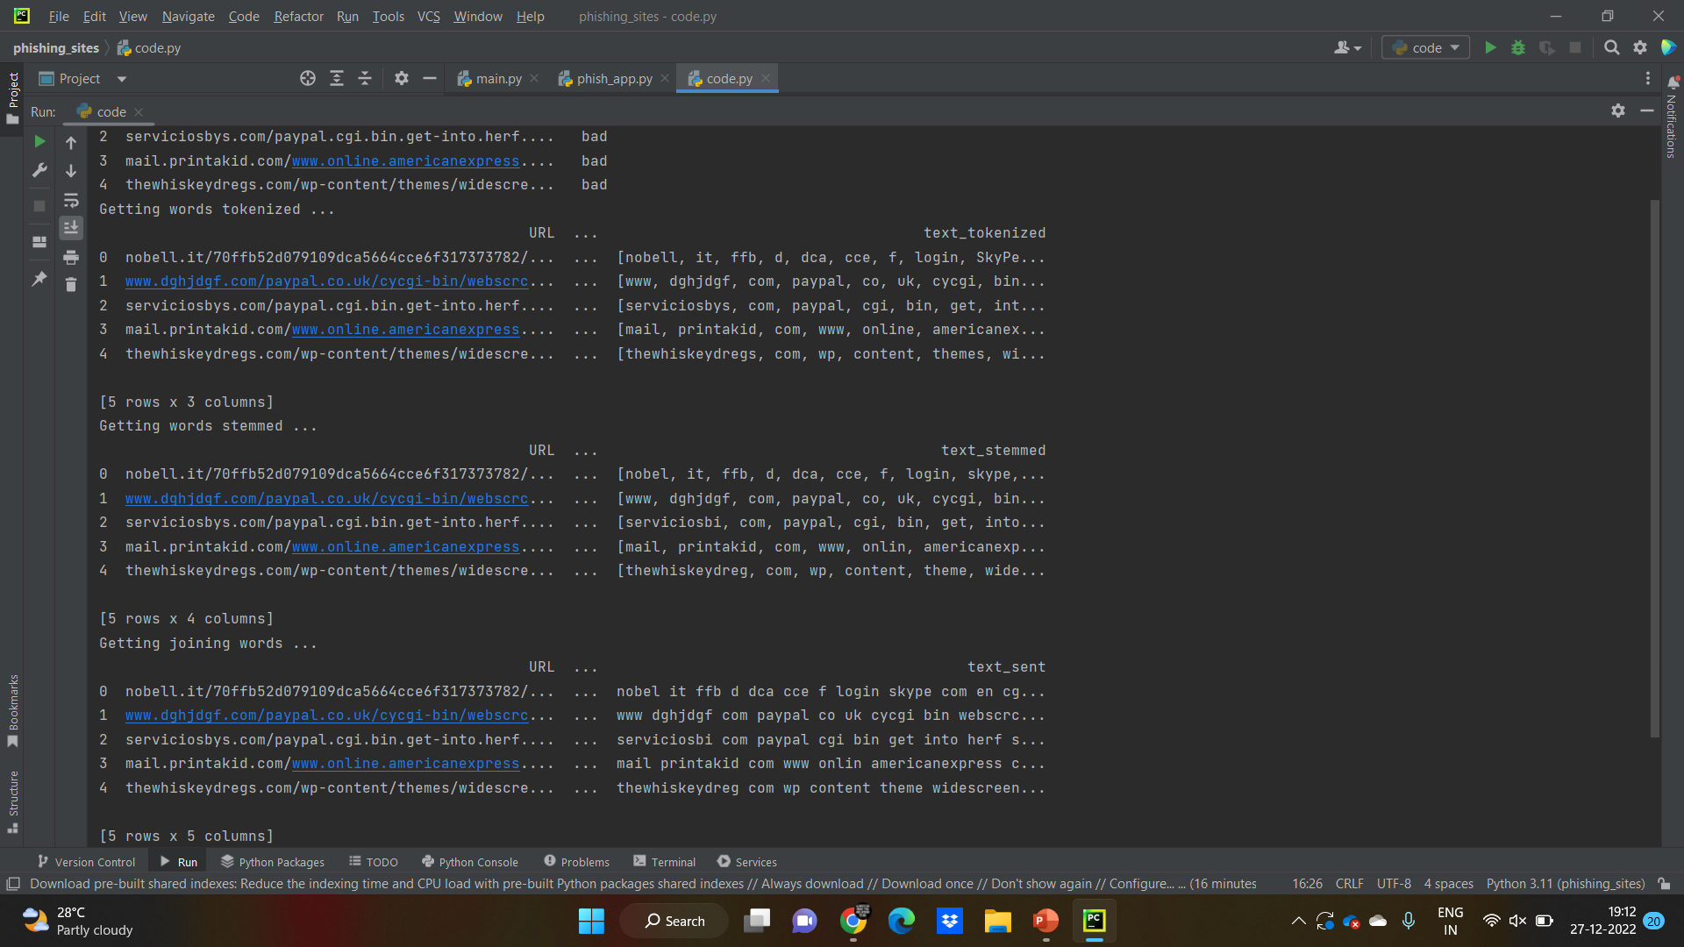

Slide 10
Modules Identified in the system
. Data Collection:
The system must be capable of collecting data related to the website's URL, domain name, information that can help in identifying a phishing site.
Data pre-processing
Data preprocessing is a data mining technique which is used to transform the raw data in a useful and efficient format by eliminating missing data
Feature Selection:
The system must select the most relevant features that can be used for predicting whether a website is a phishing site or not.
Model selection:
We applied logistic regression and Naïve Bayes algorithms to model and train our model and at the end logistic regression which gave a more accurate prediction was used in our system.

Slide 11
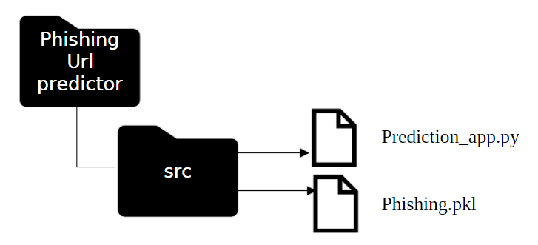
Model Deployment using FAST API:
Prediction_app.py: This file will contain the code which will start the uvicorn server. This file will also create an instance of FastAPI () which is the main point of interaction to create the API.
Phishing: This file contains the dump of the machine learning model with function which will be called when our program is running to predict malicious URL

Slide 12
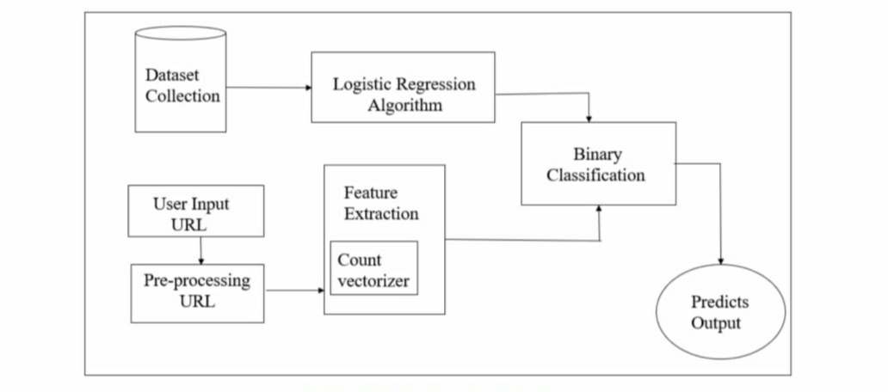
System Architecture:

Slide 13
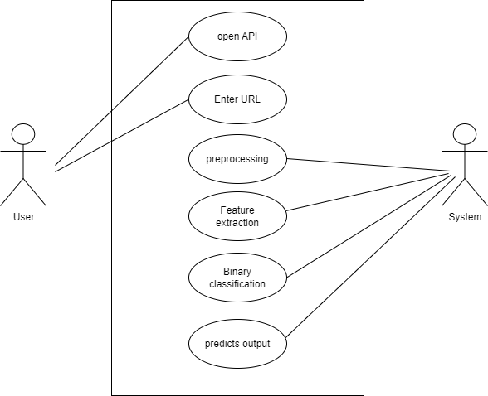
UML Diagrams
Use Case Diagram:
A use case diagram at its simplest is a representation of a user’s interaction with the system and depicting the specifications of the use case.

Slide 14
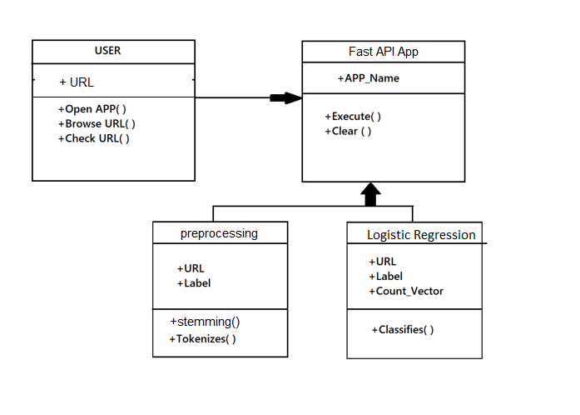
Class Diagram :
A class diagram in the Unified Modelling Language (UML) is a type of static structure diagram that describes the structure of a system

Slide 15
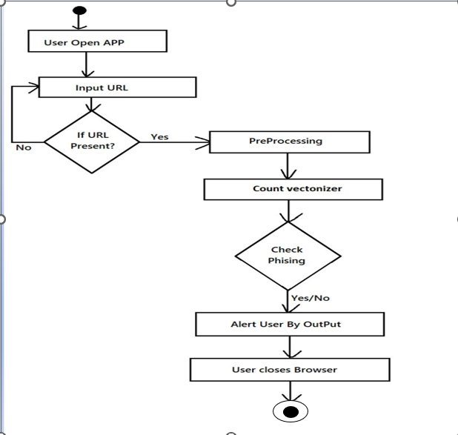
Activity diagram :
An activity diagram visually presents a series of actions or flow of control in a system similar to a flowchart or a data flow diagram.

Slide 16
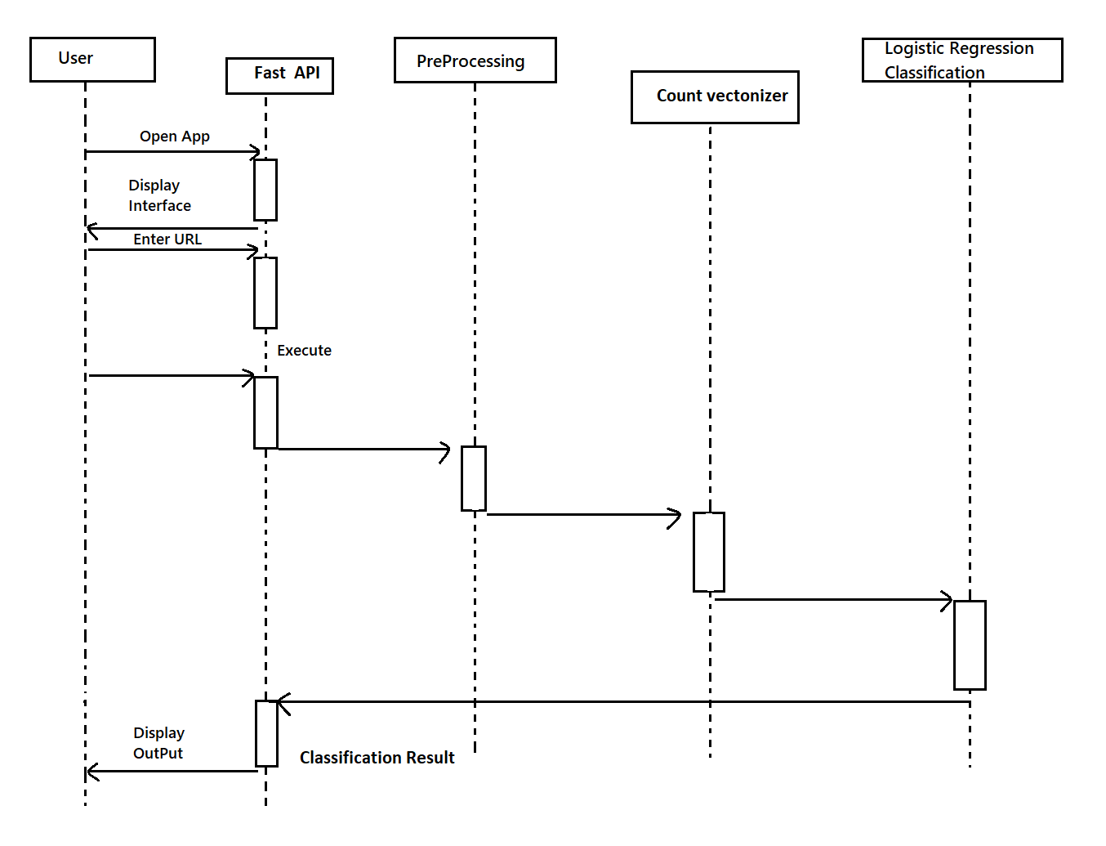
Sequence diagram:
A sequence diagram is a type of interaction diagram because it describes how and in what order a group of objects works together.

Slide 17
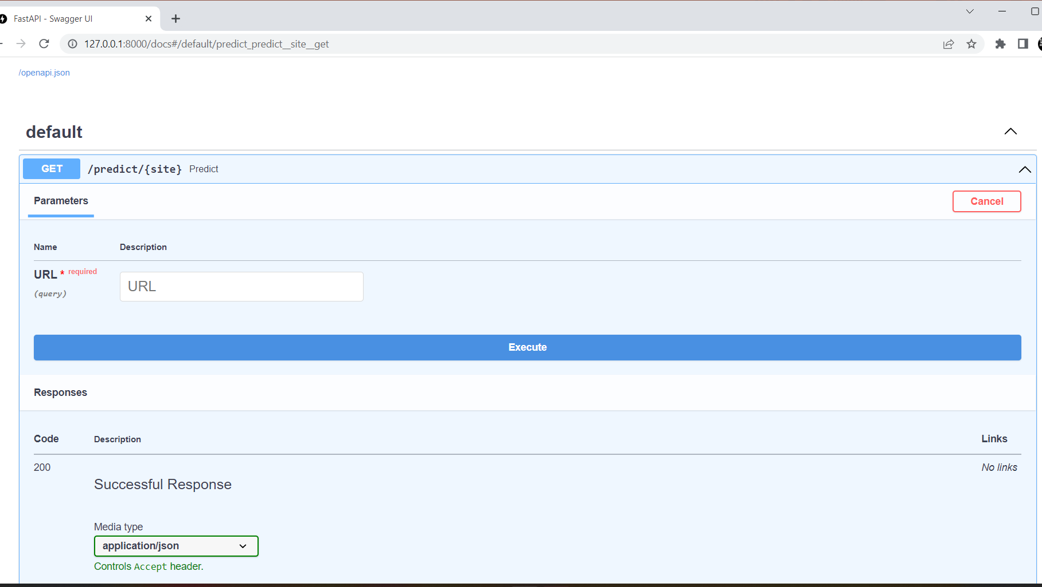
User Interface screen Design

Slide 18
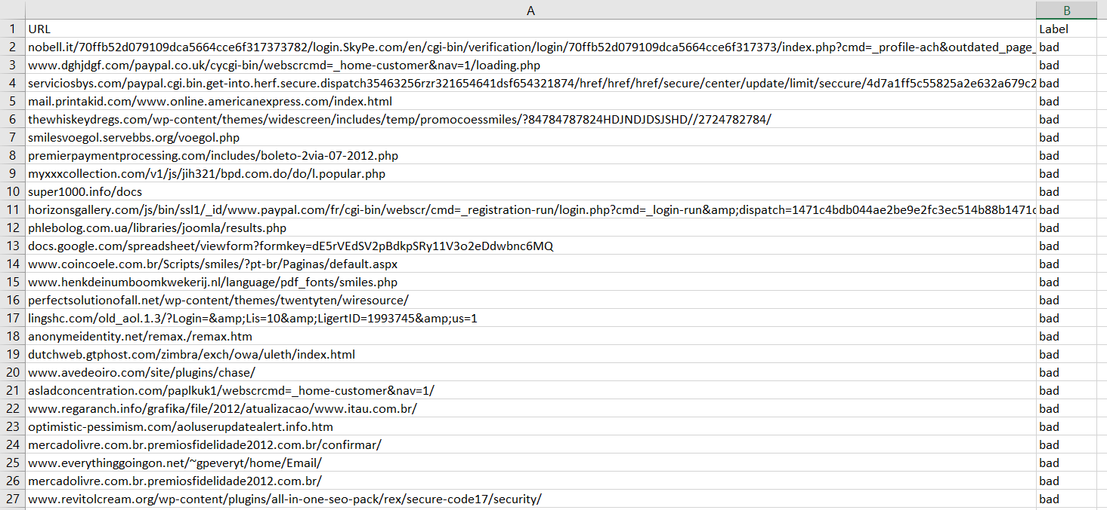
Dataset Structure

Slide 19
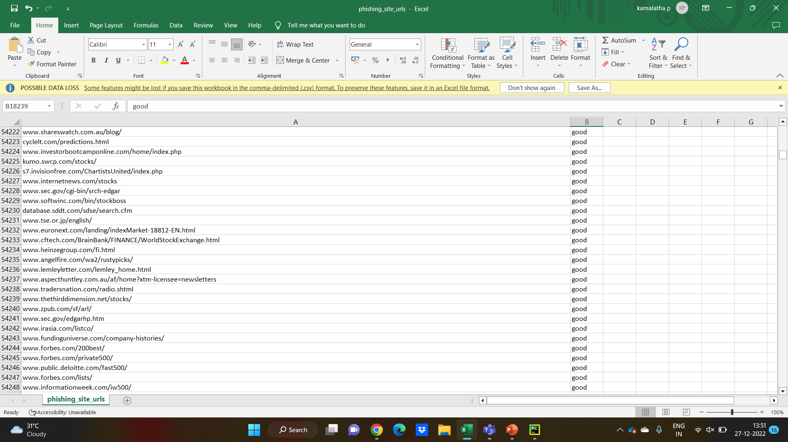

Slide 20
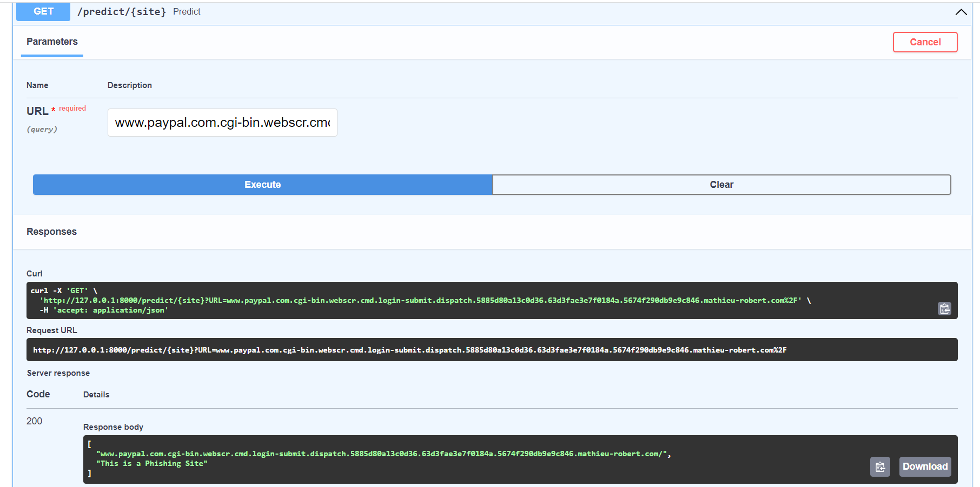
Output Screenshots

Slide 21
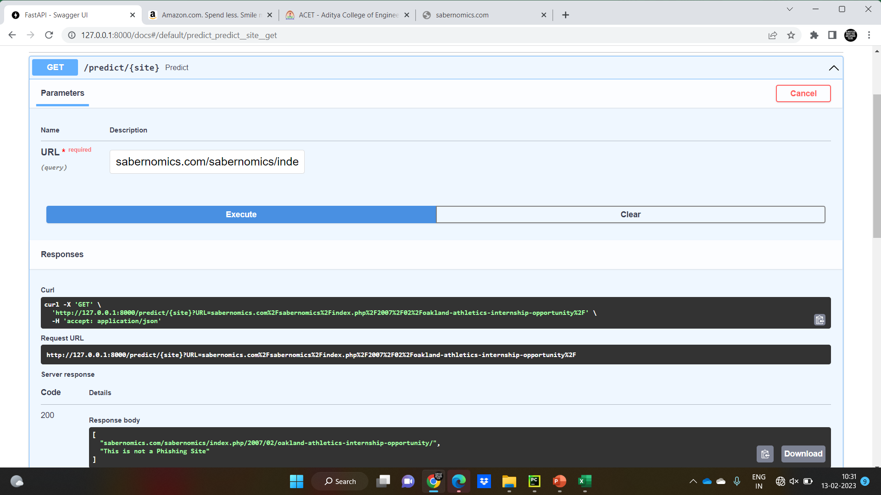

Slide 22
Conclusion
The malicious web page is created as if a legitimate web page, especially copying the original web page one to one. Therefore, detection of these pages is a very trivial problem to overcome due to its semantic structure which takes the advantage of the human vulnerabilities.
However, they are static algorithms and cannot identify the new type of attacks in the system. Therefore, as an efficient solution, we propose the use of logistic regression machine learning system for classifying the incoming URLs. The experimental results show that Logistic regression approach result gives best results of 97 % Accuracy.

Slide 23
BIBLIOGRAPHY
[1]https://www.researchgate.net/publication/346534722_Phishing_website_detection_ using_support_vector_machines_and_nature-inspired_optimization_algorithms
[2] https://ijarsct.co.in/Paper1412
[3] https://www.sciencedirect.com/science/article/pii/S187770581200940X
[4] https://link.springer.com/chapter/10.1007/978-981-33-4299-6_12
[5]https://www.researchgate.net/publication/2614079_Genetic_Algorithms_and_Heuristic_Search
[6] https://arxiv.org/pdf/2009.11116.pdf
[7] https://cybersecurity.springeropen.com/articles/10.1186/s42400-022-00126-9

Slide 24
Thank You

